Slide 1
Discussion of Greedy Search, A* and SMA*

Slide 2
Best-first search
Idea: use an evaluation function f(n) for each node
estimate of "desirability"
Expand most desirable unexpanded node
Implementation:
Order the nodes in fringe in decreasing order of desirability
Special cases:
greedy best-first search
A* search A* variations such as SMA*

Slide 3
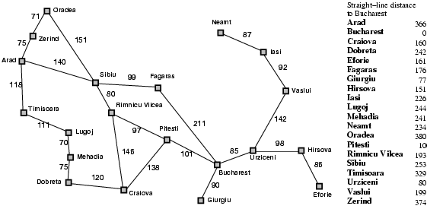
Romania with step costs in km

Slide 4
Greedy best-first search
Evaluation function f(n) = h(n) (heuristic): estimate of cost from n to goal
e.g., h_{SLD}(n) = straight-line distance from n to Bucharest
Greedy best-first search expands the node that appears to be closest to goal

Slide 5

Greedy best-first search example

Slide 6
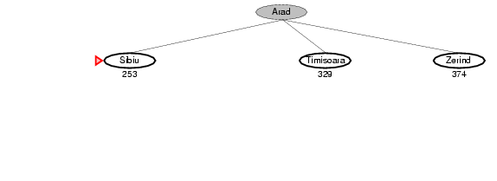
Greedy best-first search example

Slide 7
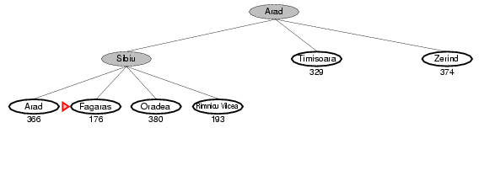
Greedy best-first search example

Slide 8
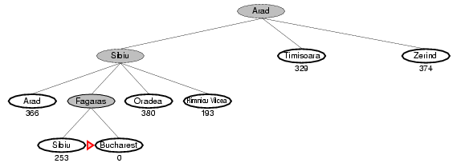
Greedy best-first search example

Slide 9
Properties of greedy best-first search
When it evaluates a node n it only considers the cost to the goal state (h(n)) but ignores the cost of reaching n from the initial state (g(n))
Complete? No – can get stuck in loops, e.g., Iasi → Neamt → Iasi → Neamt →
Time? O(b^{m}), but a good heuristic can give dramatic improvement
Space? O(b^{m}) -- keeps all nodes in memory
Optimal? No

Slide 10
Side Discussion “Greedy Algorithms”
Makes locally optimal choices at each stage
Fast and therefore attractive to solve NP-hard and other problems with high complexity. Later decisions are made in the context of decision selected early dramatically reducing the size of the search space.
They do not backtrack: if they make a bad decision (based on local criteria), they never revise the decision.
They are not guaranteed to find the optimal solution(s), and sometimes can get deceived and find really bad solutions.
In spite of what is said above, a lot successful and popular algorithms in Computer Science are greedy algorithms.
Greedy algorithms are particularly popular in AI and Operations Research.
See also: http://en.wikipedia.org/wiki/Greedy_algorithm
Popular Greedy Algorithms: Decision Tree Induction,…

Slide 11
A* search
Idea: avoid expanding paths that are already expensive
Evaluation function f(n) = g(n) + h(n)
g(n) = cost so far to reach n
h(n) = estimated cost from n to goal
f(n) = estimated total cost of path through n to goal

Slide 12

A* search example

Slide 13
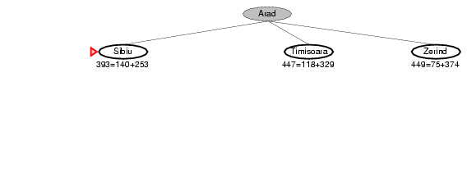
A* search example

Slide 14
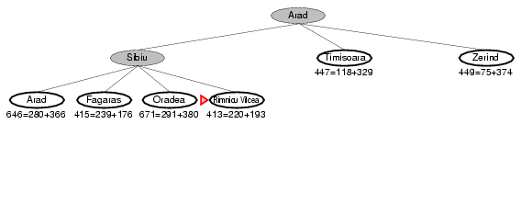
A* search example

Slide 15
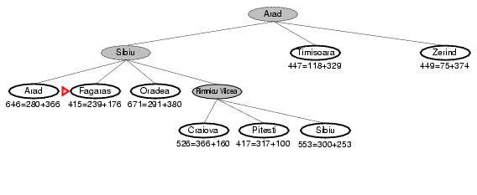
A* search example

Slide 16
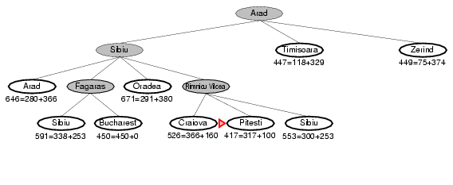
A* search example

Slide 17
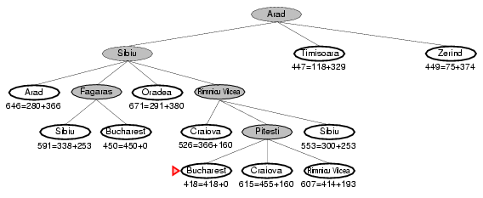
A* search example

Slide 18
Admissible heuristics
A heuristic h(n) is admissible if for every node n,
h(n) ≤ h*(n), where h*(n) is the true cost to reach the goal state from n.
An admissible heuristic never overestimates the cost to reach the goal, i.e., it is optimistic
Example: h_{SLD}(n) (never overestimates the actual road distance)
Theorem: If h(n) is admissible, A* using TREE-SEARCH is optimal

Slide 19
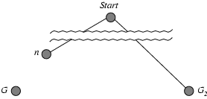
Optimality of A* (proof)
→Group B Online Credit Task
Suppose some suboptimal goal G₂ has been generated and is in the fringe. Let n be an unexpanded node in the fringe such that n is on a shortest path to an optimal goal G.
f(G₂) > f(G) from above
h(n) ≤ h*(n) h* measures the “true cost” since h is admissible
g(n) + h(n) ≤ g(n) + h*(n)
f(n) ≤ f(G)
Hence f(G₂) > f(n), and A* will never select G₂ for expansion; Contradiction: Algorithm would have not terminated at G2 and expanded n instead because f(n)<f(G)≤f(G2)

Slide 20
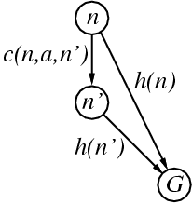
Consistent heuristics
A heuristic is consistent if for every node n, every successor n' of n generated by any action a,
h(n) ≤ c(n,a,n') + h(n')
If h is consistent, we have
f(n') = g(n') + h(n')
= g(n) + c(n,a,n') + h(n')
≥ g(n) + h(n)
= f(n)
i.e., f(n) is non-decreasing along any path.
Theorem: If h(n) is consistent, A* using GRAPH-SEARCH is optimal
Remark: Optimal means A* directly moves to the goal state

Slide 21
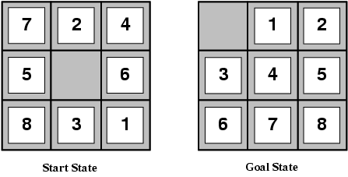
Admissible heuristics
E.g., for the 8-puzzle:
h₁(n) = number of misplaced tiles
h₂(n) = total Manhattan distance
(i.e., no. of squares from desired location of each tile)
h₁(S) = ? 8
h₂(S) = ? 3+1+2+2+2+3+3+2 = 18

Slide 22
Dominance
If h₂(n) ≥ h₁(n) for all n (both admissible)
then h₂ dominates h₁
h₂ is better for search
Typical search costs (average number of nodes expanded):
d=12 IDS = 3,644,035 nodes A*(h₁) = 227 nodes A*(h₂) = 73 nodes
d=24 IDS = too many nodes A*(h₁) = 39,135 nodes A*(h₂) = 1,641 nodes

Slide 23
SMA* Algorithm
Khadija
https://en.wikipedia.org/wiki/SMA*
http://www2.cs.uh.edu/~ceick/ai/SMA.pdf
Modifies A* to work with a limited memory
Key Idea:
Uses a given amount of memory to remember nodes so that they don’t have to be repeatedly regenerated.
Utilizes whatever memory is made available to it.
It avoids repeated states as far as its memory allows.

Slide 24
SMA* Algorithm
Khadija
Steps:
• Expand deepest lowest f-cost leaf-node (Best first search on f-cost)
• Update f-cost of nodes whose successors have higher f-cost
• Drop shallowest & highest f-cost leaf node
• remember best forgotten descendant
• Paths longer than node limit get ∞ cost.

